Slide 1
Capstone Project - The Battle of Neighborhoods
- Sisodia Archi

Slide 2
This Presentation is the part of capstone project of IBM DATA SCIENCE CERTIFICATE. The main aim of this project is to apply every skill and tools learned from this course and apply for solving a business problem where we can use the Foursquare location data.

Slide 3
Table of Content
Business Problem
Target Audience
Data Description
Methodology
Results & Outcomes
Conclusion

Slide 4
1. Business Problem
The largest city of Canada Toronto is one of the most multicultural cities in the world, making life in Toronto a wonderful multicultural experience for all. Mostly Immigrants are living in canda so they have given different cuisine, religious place, ethnic stores every one gives the hints of there culture. The aim of this project is to find the best neighborhood in Toronto to open a restaurant using foursquare location data. In this project we’ll go through the solution for this problem for avoiding or considering low risk criteria and high success rate.

Slide 5
2. Target Audience
Business professional who wants to invest or open a restaurant.
students or bachelors who want to stay in a Toronto and want to find facilities like Library, saloon, GYM, Club, Playground, Movie theatre etc.
The freelancer who loves to have their own small company or restaurant as a side business.
Marketing companies who want to release a new product on a best place.
People or Tourist who wants to eat Indian food.

Slide 6
3. Data Description
1. Toronto City data that contains Borough, Neighborhoods along with there latitudes and longitudes
Data Source: https://en.wikipedia.org/wiki/List_of_postal_codes_of_Canada:_M
Description: This Wikipedia page contains all the information we need to explore and cluster the neighborhoods in Toronto. We will be required to scrape the Wikipedia page and wrangle the data, clean it, and then read it into a pandas data frame so that it is in a structured format like the Toronto dataset.
2. Geographical Location data using Geocoder Package
Data Source: https://cocl.us/Geospatial_data
Description: It is the Geographical coordinates of the neighborhoods with the respective Postal Codes.
3. Venue Data using Foursquare API
Data Source: https://foursquare.com/developers/apps
Description: From Foursquare API we can get the name,category,latitude,longitude for each venue.

Slide 7
4. Methodology
After scraping the data from Wikipedia there were Boroughs that were not assigned to any neighborhood therefore, the following assumptions were made:
Only process the cells that have an assigned borough. Ignore cells with a borough that is Not assigned. More than one neighborhood can exist in one postal code area. For example, in the table on the Wikipedia page, you will notice that M5A is listed twice and has two neighborhoods: Harbourfront and Regent Park. These two rows will be combined into one row with the neighborhoods separated with a comma as shown in row 11 in the above table. If a cell has a borough but a Not assigned neighborhood, then the neighborhood will be the same as the borough.We will merge the two tables together based on Postal Code using the Latitude and Longitude collected from the Geocoder package.

Slide 8
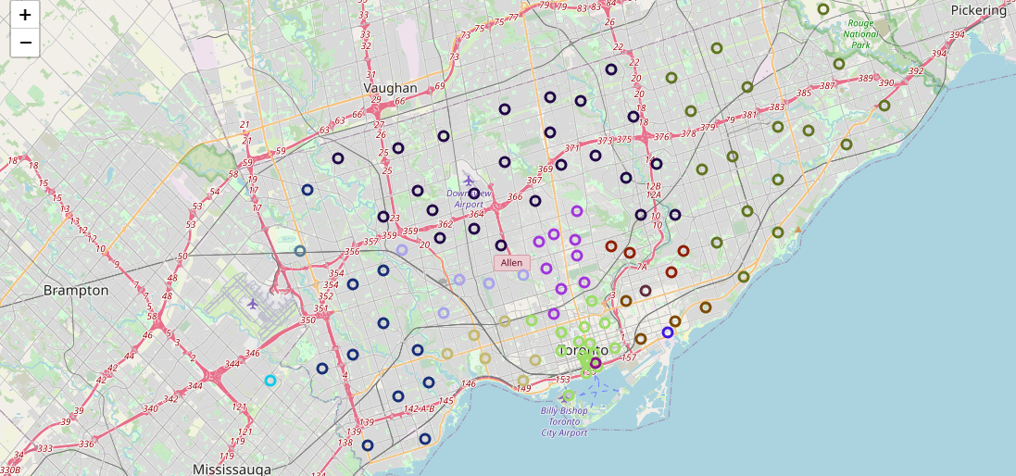
we need to visualize all neighborhoods in a map using Folium and color-coded each.

Slide 9
K-Means Clustering
Now we’ll cluster these neighborhoods based on the frequency of Indian restaurants present. To do this we apply k-means clustering algorithm. To avoid the over fitting and under fitting of the model we need a optimum value of “k”.There are many techniques like Elbow method, Silhouette score method to get the best “k” value.Herewe’r going to use Elbow method to get best “k” value. We’ll import ‘KElbowVisualizer’ from the Yellowbrick package. Then we fit our K-Means model above to the Elbow visualize.

Slide 10

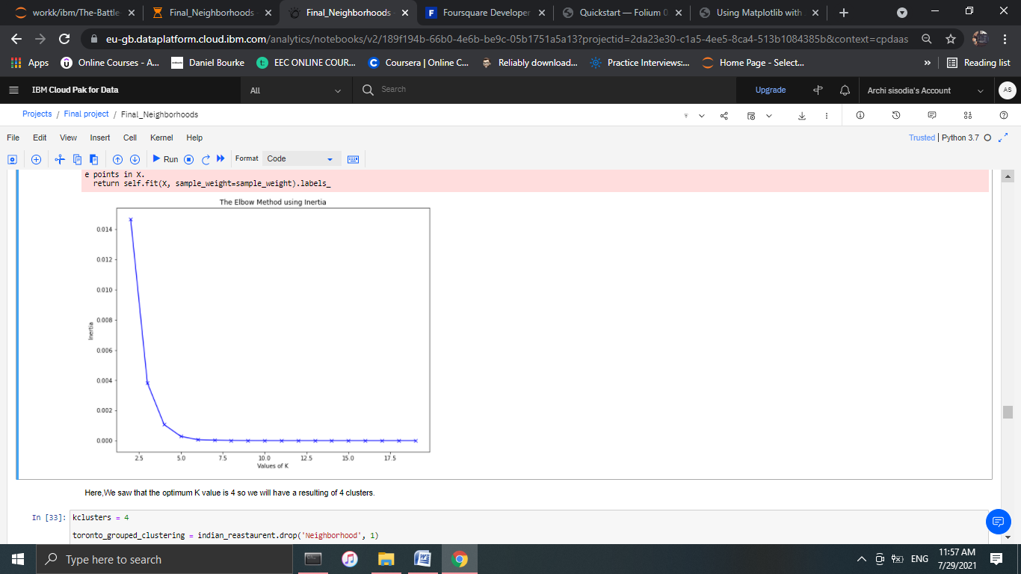

Slide 11
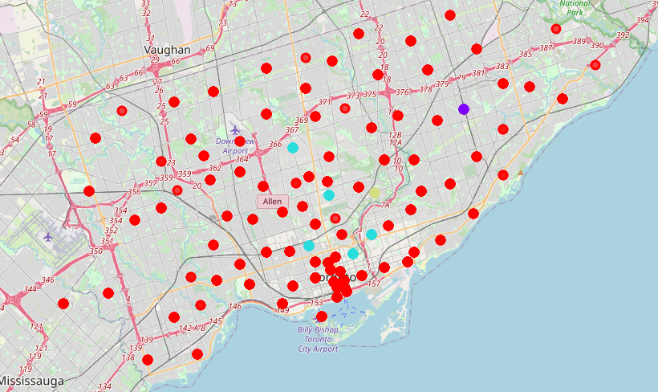
5. Result & Outcomes
The below bar chart shows how many neighborhood present in each cluster.
The map below shows the different clusters that had a similar mean frequency of Indian restaurants.

Slide 12
6. Conclusion
In conclusion, to end off this project, we had an opportunity on a business problem, and it was tackled in a way that it was similar to how a genuine data scientist would do.

